Slide 1
Introduction to Computer Hardware and Operating Systems Part 1
Bits, Bytes, and Everything Nice: Unpacking the Essentials of Computer Hardware and Operating Systems

Slide 2
Objective
Objective: To introduce the fundamental concepts of computer hardware components and their interaction with operating systems.

Slide 3
Objectives
Understanding key hardware components.
Overview of operating system functionalities.
Exploration of storage options and virtualization concepts.

Slide 4
Introduction to Computer Hardware
Definition: Hardware refers to the physical parts of a computer system that you can touch and see.
Importance: Without hardware, your computer would just be an idea! Hardware components are the foundation that allows software to run and enables all the amazing things computers can do.

Slide 5
The CPU (Central Processing Unit)
The CPU is responsible for executing instructions from both software and hardware. It performs the logic, arithmetic, and input/output operations specified by the instructions.
Core: The core of the CPU carries out the execution of program instructions.
Clock Speed: Measured in gigahertz (GHz), clock speed determines how many instructions per second the CPU can execute.

Slide 6
Introduction to Basic Computer Terminology
Purpose: Before we explore how the components of a computer work together, let's define some fundamental terms that will appear throughout our discussion.

Slide 7
The CPU (Central Processing Unit)
The CPU is responsible for executing instructions from both software and hardware. It performs the logic, arithmetic, and input/output operations specified by the instructions.
Core: The core of the CPU carries out the execution of program instructions.
Clock Speed: Measured in gigahertz (GHz), clock speed determines how many instructions per second the CPU can execute.

Slide 8
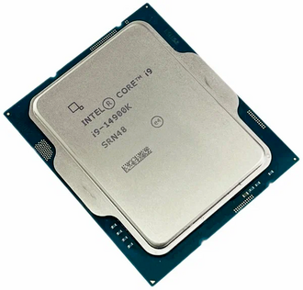
The CPU (Central Processing Unit)

Slide 9
Processor Architecture Explained
Registers:
Definition: Small, fast storage locations directly inside the CPU used to hold temporary data and instructions.
Combinational Logic:
Definition: Circuitry within the processor that performs basic arithmetic, logic, and data storage operations without needing sequential memory.

Slide 10
Understanding CPU Cache
Cache is a small-sized type of volatile computer memory that provides high-speed data access to the CPU and stores frequently used computer programs, applications, and data.
Functionality:
Speed: Cache memory is faster than the main memory and is designed to speed up the transfer of data and instructions.
Levels of Cache:
L1 Cache: Directly integrated into the CPU chip, fastest cache level.
L2 Cache: Slightly slower than L1, also on the CPU chip or sometimes on a separate chip but close to the CPU.
L3 Cache: Slower and larger than L1 and L2, shared among cores in multi-core processors.

Slide 11
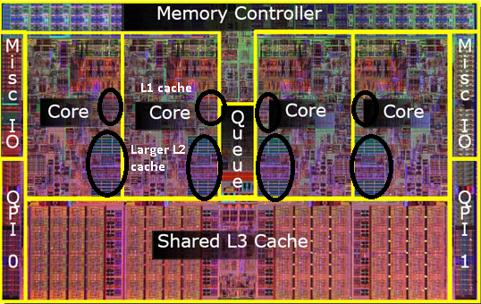
Understanding CPU Cache
Each core has an L2/L2 cache
L3 is shared among all the cores.

Slide 12
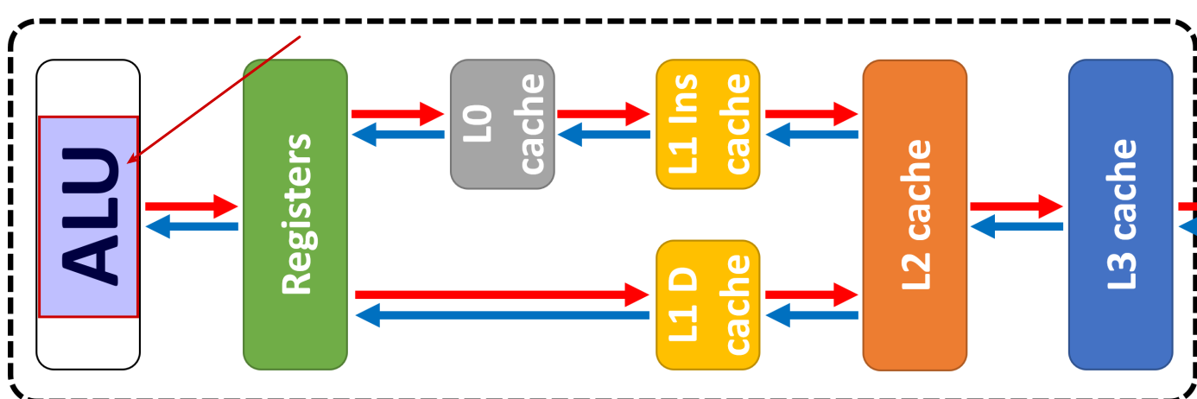
ALU (Arithmetic Logic Unit)

Slide 13
ALU (Arithmetic Logic Unit)
Heart of the CPU: The ALU is a core component within the CPU responsible for performing calculations and logical operations.
What it Does: It takes data from registers, performs operations like addition, subtraction, or comparisons, and then stores the result back into a register.

Slide 14
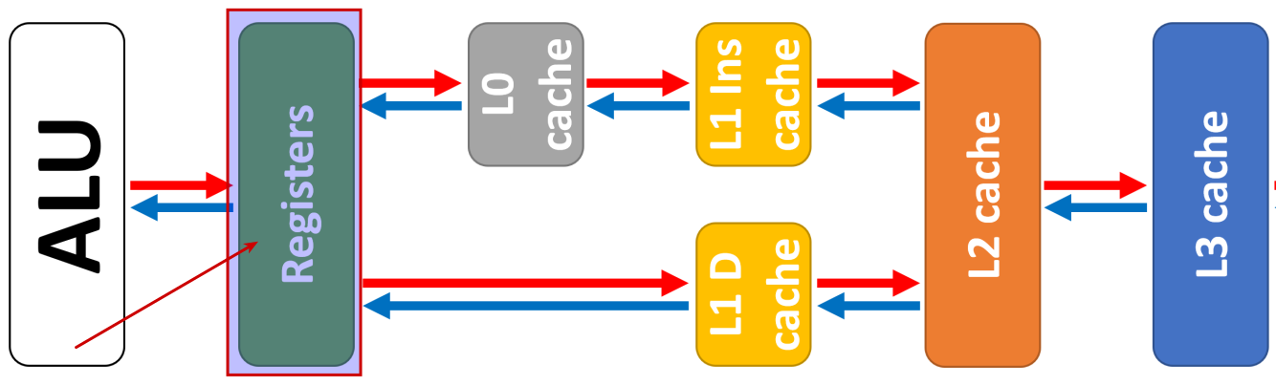
Registers

Slide 15
Registers
CPU's Tiny Sticky Notes: Registers are extremely small, high-speed memory locations built directly into the CPU itself.
Purpose: They hold the immediate data and instructions the ALU is actively working on. It's like having the ingredients right next to the stove when cooking.
Size: Registers are measured in bits. A typical register might be 32 bits or 64 bits, allowing it to hold a single number, a piece of an instruction, or a memory address.

Slide 16
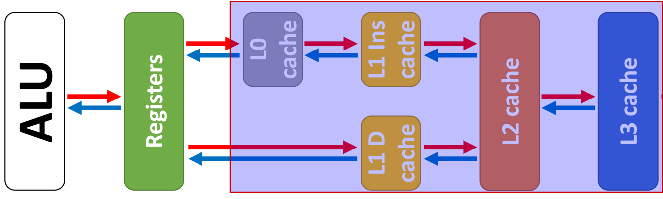
CACHE (still part of the CPU “package”)

Slide 17
CACHE (still part of the CPU “package”)
The Middle Ground: Cache is a type of memory that sits between the CPU and main RAM. It's faster than RAM but slower than registers.
Purpose: Cache stores frequently used data and instructions. This way, the CPU doesn't always have to go all the way out to the slower RAM for everything it needs. Think of it as the pantry in your kitchen – closer than the grocery store!
Size: Cache is measured in kilobytes (KB) or megabytes (MB). It has multiple levels:
L1: Smallest, fastest, closest to the CPU
L2: A bit larger, bit slower
L3: Largest of the cache levels, still faster than RAM

Slide 18
How They Work Together
Fetch: The CPU needs data or instructions.
Check Cache: The CPU first looks in the cache. If it finds what it needs (a "cache hit"), great! It grabs it quickly.
Miss: If the data isn't in the cache ("cache miss"), the CPU has to fetch it from the slower main RAM and also bring a copy into the cache in case it's needed again soon.

Slide 19
Size Matters
Registers: Super tiny – think of single ingredients.
Cache: Way bigger than registers, but still much smaller than main RAM. Holds larger chunks of data – like multiple recipes.
RAM: Largest of the three – holds your whole cookbook collection!

Slide 20
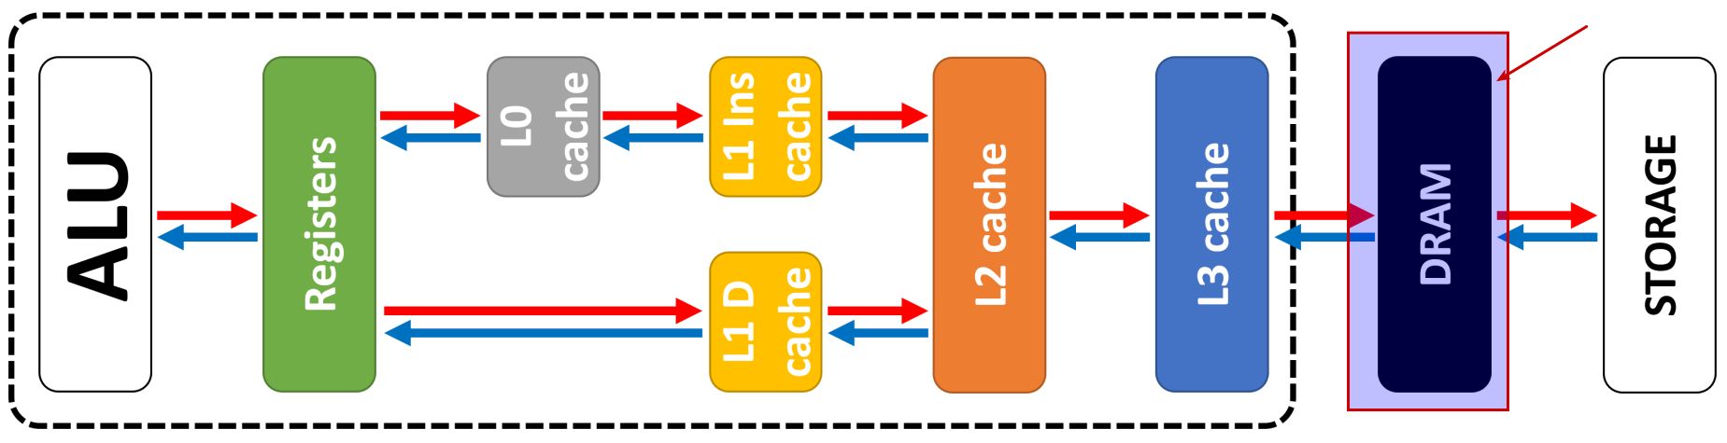
From Registers to Main Memory (DRAM)
DRAM is an expandable module on the motherboard. This region is no longer on the CPU package.

Slide 21
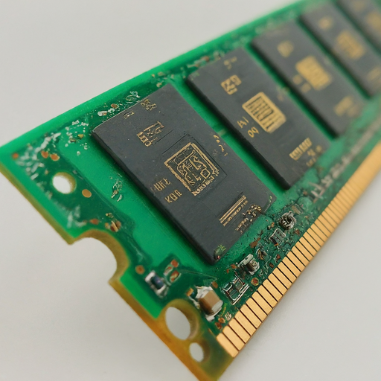
From Registers to Main Memory (DRAM)
DRAM is an expandable module on the motherboard. This region is no longer on the CPU package.

Slide 22
From Registers to Main Memory (DRAM)
Cache Efficiency: While cache greatly improves performance, it's still limited in size.
DRAM (Dynamic Random Access Memory): This is the computer's main memory, often referred to as RAM. DRAM is much larger than cache, allowing it to store a wider range of data and programs.
Slower Access: DRAM is slower than cache, but still significantly faster than storage devices like hard drives or solid-state drives (SSDs). Imagine DRAM as your main kitchen stocked with all the ingredients you use regularly.

Slide 23
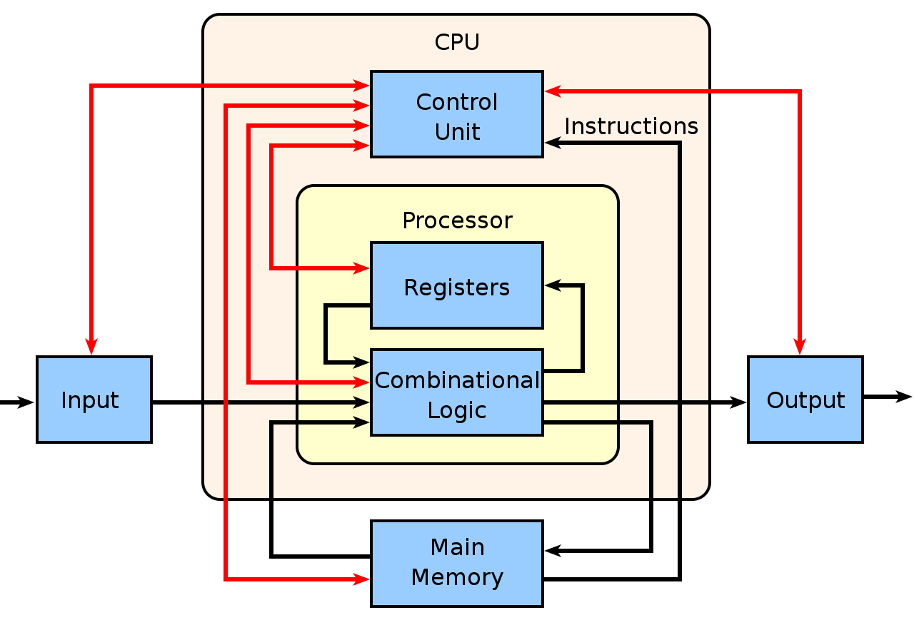
From Registers to Main Memory (DRAM)

Slide 24
DRAM vs. Storage
Focus on Active Use vs. Long-Term Storage: DRAM holds data and programs that are currently in use by the CPU or likely to be needed soon.
Storage Devices: Hard drives (HDDs) and solid-state drives (SSDs) provide long-term storage for your computer's data and programs, even when the computer is turned off. Think of storage as your pantry and cabinets – holding all the ingredients you don't need immediately but might use in the future.

Slide 25
From Main Memory (DRAM) to Storage
DRAM's Limitation: DRAM is fantastic for keeping frequently used data readily available, but it has a crucial drawback: it's volatile.
Volatility Explained: This means that when you turn off your computer, all the data in DRAM is erased. Imagine if your kitchen magically forgot where you stored all the ingredients every night!

Slide 26
The Role of Storage
Long-Term Solution: This is where storage devices come in. They provide non-volatile storage, meaning your data persists even after the computer is powered off. Storage acts like your pantry and cabinets at home, where you keep ingredients for long-term use.
Common Storage Types:
Hard Disk Drive (HDD): Uses spinning platters to store data magnetically. HDDs are slower but offer larger capacities and lower costs per gigabyte.
Solid-State Drive (SSD): Uses flash memory chips to store data electronically. SSDs are significantly faster but have smaller capacities and are typically more expensive per gigabyte.

Slide 27
This mornings task
Download Debian ISO and create a bootable drive
Form groups (size to be determined by number of students and available hardware).

Slide 28
Morning homework
You will be required to identify hardware, and will be verbally tested on the material in the following assigned homework.
This live evaluation will be graded.

Slide 29
How Motherboards Work
The article "How Motherboards Work" on HowStuffWorks gives an in-depth understanding of the role and components of a motherboard. Check it out here: How Motherboards Work.

Slide 30
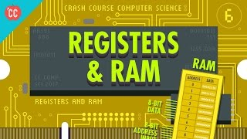
Watch Carrie Anne’s crash course on registers and RAM

Slide 31
Afternoon
Be ready for room C309 at 1:30 PM

